Slide 1


Uniwallet
Finance Management
App for University
Students

Slide 2

Empowering Students to Manage Their Finances
The students face financial challenges as they manage their own finances. With limited income sources and various expenses, many struggle with budgeting and financial stress.

Slide 3


Objectives of Unifinance app
Track expenditures effectively.
Set and manage budgets.
Visualize financial data for better decision-making.
Alerts for budget limits.
Visualization of Financial Data through graphs, Pie charts

Slide 4

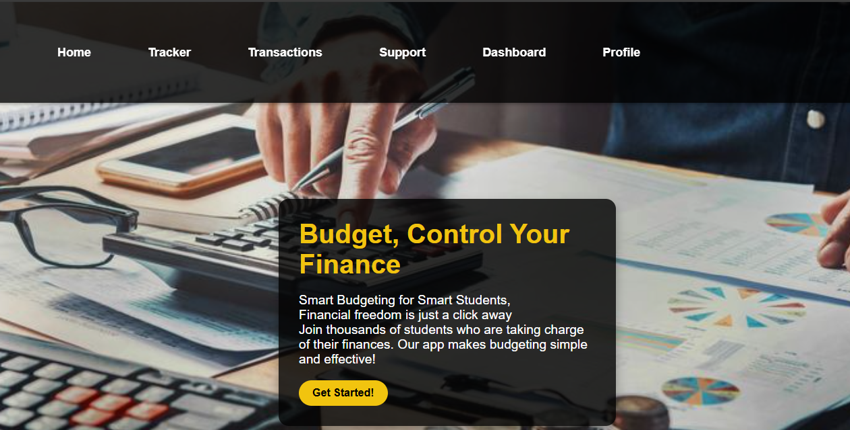

Features of the app
User-Friendly Interface: Easy navigation designed for students.
Expense Tracking: Simple logging and categorization of expenses.
Budgeting Tools: Monthly budget setting and notifications.
Visual Analytics: Graphs and charts for spending insights.
Educational Resources: Tips and links for financial literacy.

Slide 5

Development Process
Research and Planning
Conducting surveys and interviews with students to gather insights on their financial needs.
Designing
Development Phase
Code the application and ensuring security measures are in place.
Testing
Performing user testing to identify usability issues
Using the application.

Slide 6

Uniwallet
Uniwallet is an essential tool for university students, providing them with the resources needed to manage their finances effectively.

Slide 7


Uniwallet
It helps students to enhance their financial literacy and offering tools for expense tracking and budgeting, the app aims at solving financial stress, enabling students to concentrate on their studies and personal

Slide 8

THANK YOU
Uniwallet

